Slide 1

AGP Advanced Techniques
José Antonio Prieto García
Alejandro Gamarra Niño

Slide 2
Implemented techniques
Deferred rendering + light volumes
Z/Depth pre-pass
SSAO
Environment mapping

Slide 3

Deferred rendering + light volumes
Light volumes is a huge optimization of the deferred rendering itself
We render actual geometry, then calculates without depth write, the amount of light for each light volume in additive form.

Slide 4

Z/ depth pre pass
Giving some benefits from gbuffer to forward rendering
Having early depth opens to multitude of other techniques:
SSAO, SSR, screen space/deferred shadows, occlusion culling, raytracing etc

Slide 5
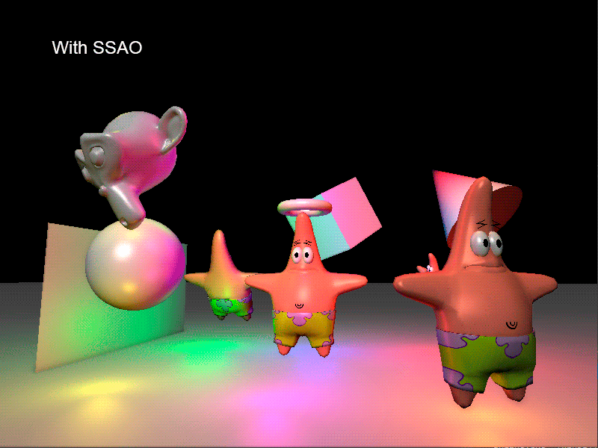
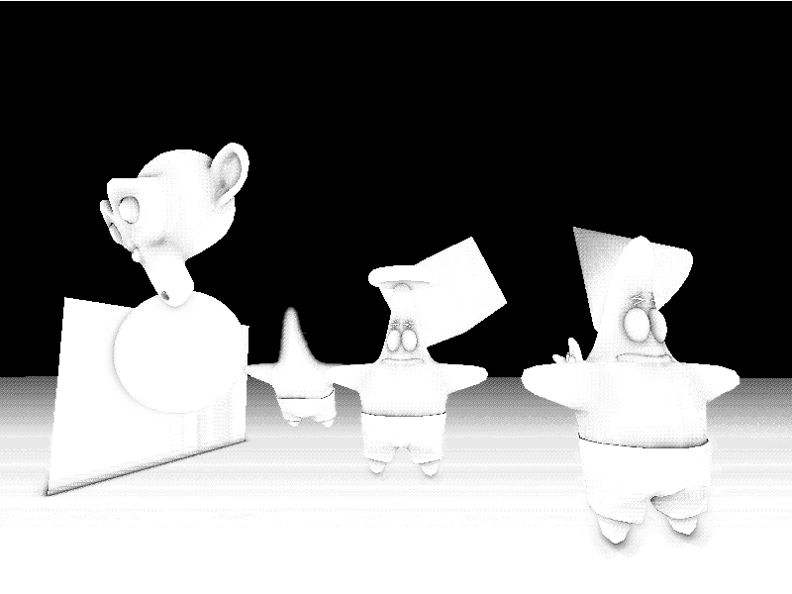
SSAO

Slide 6
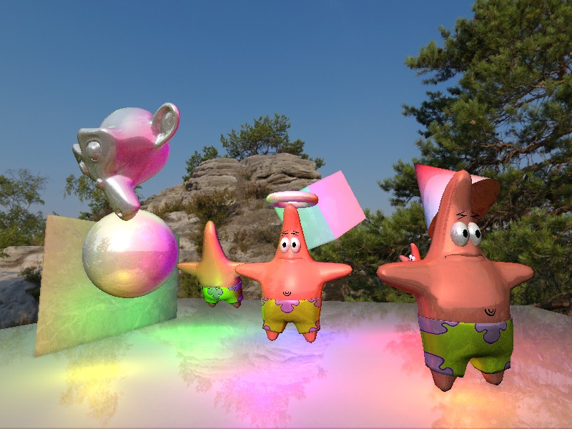
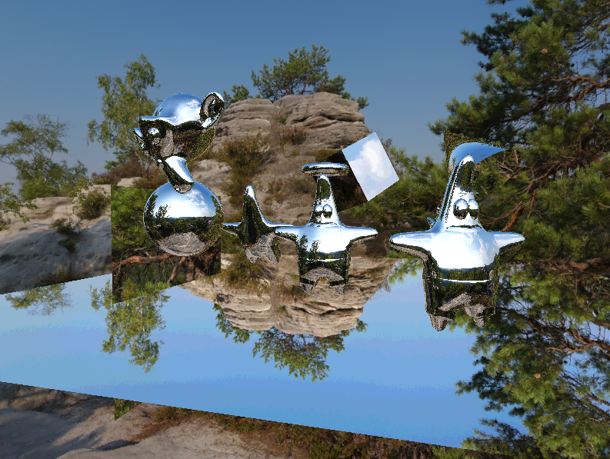
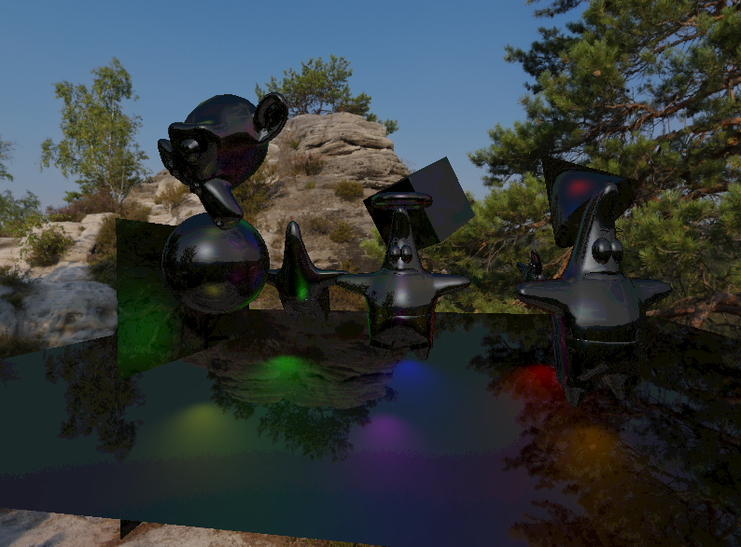
Environment Mapping
Specular Fake Reflections
Ambient + Diffuse + Specular 20%
Specular 100%

Slide 7
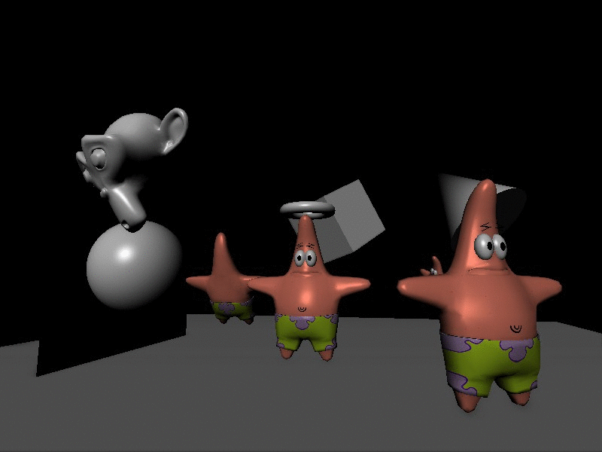
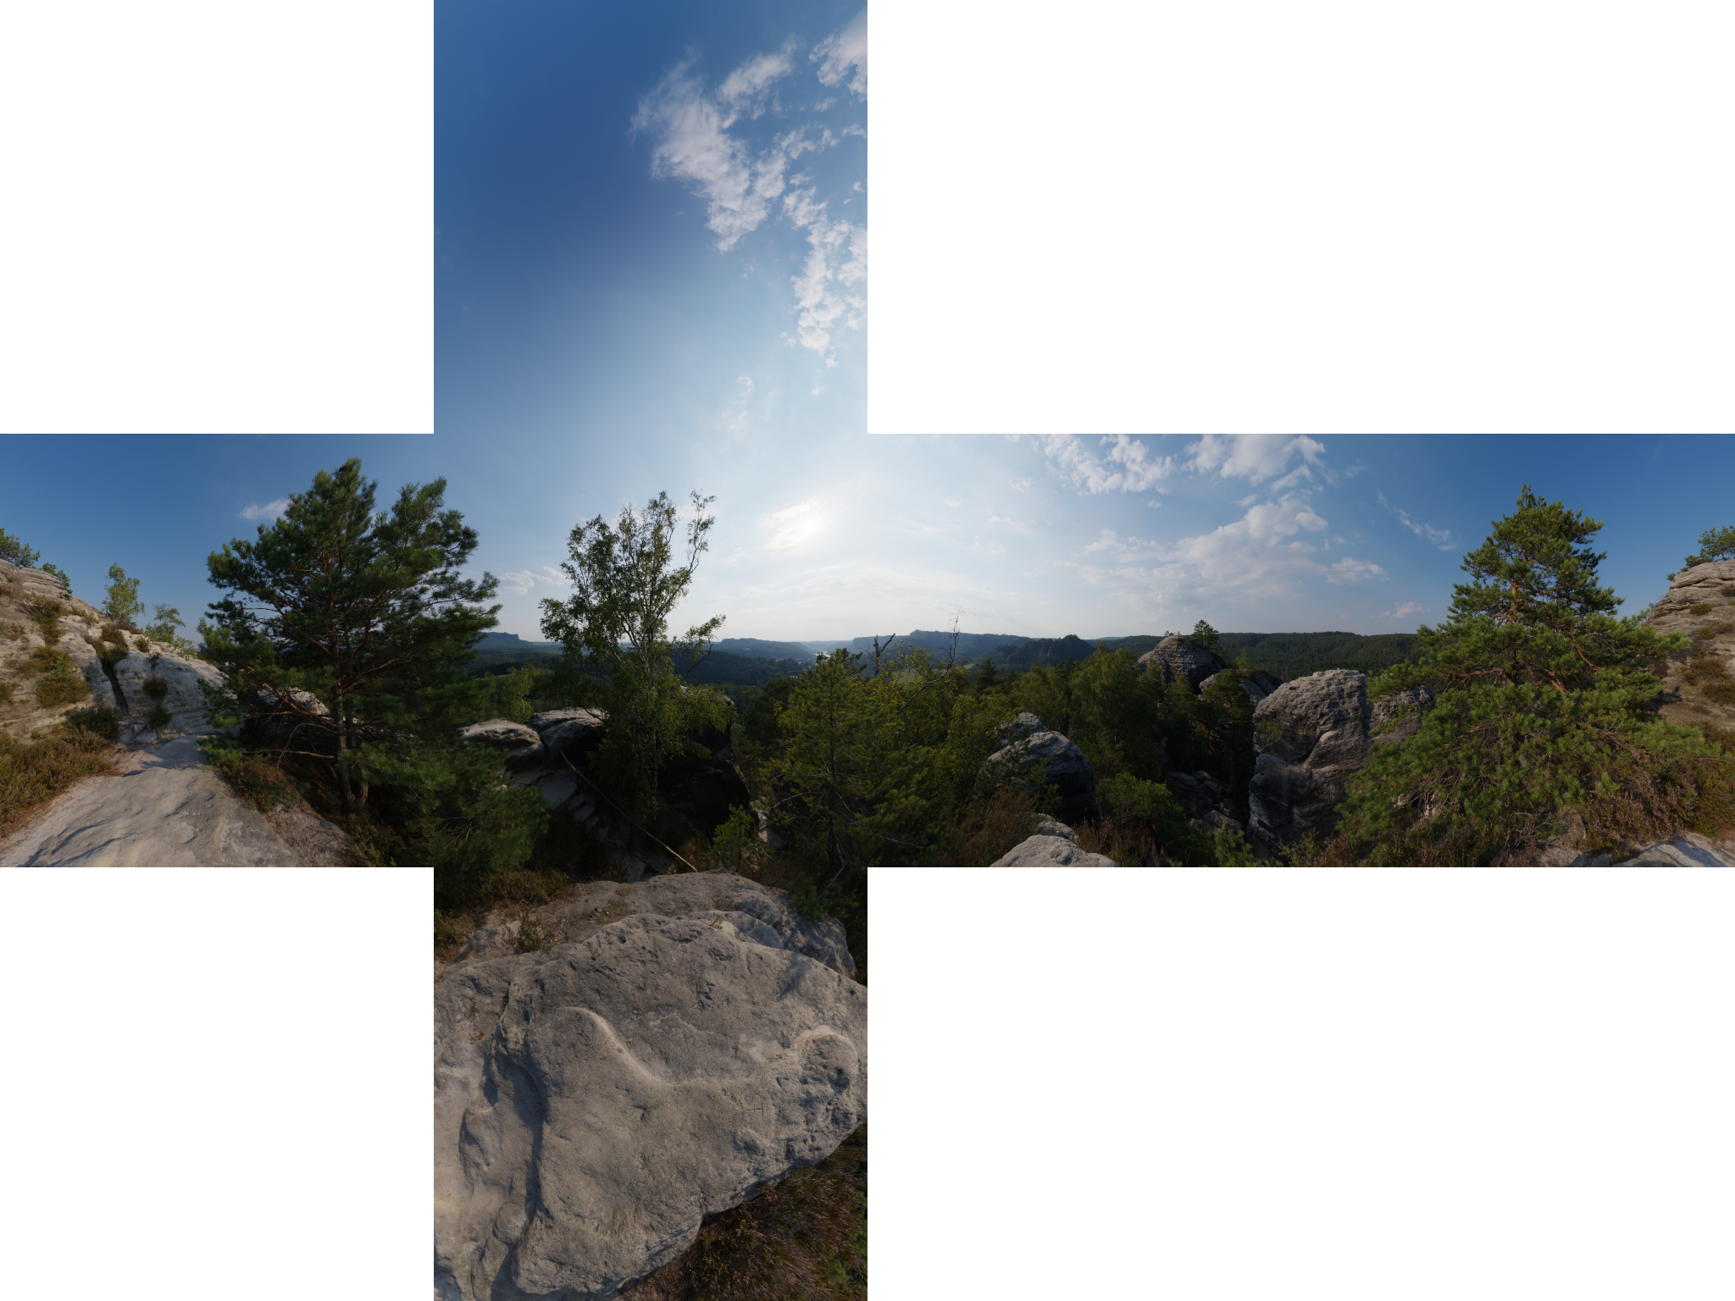
Environment Mapping
Skybox
CubeMap Texture

Slide 8
THANKS
https://github.com/SOLID-TEAM/AGP

